Slide 1
Introducing dam routing
based on operational rules
into a RAPID model
of the Yaque del Sur watershed
in the Dominican Republic

Slide 2
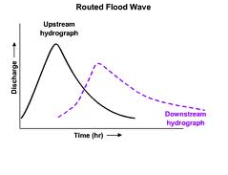
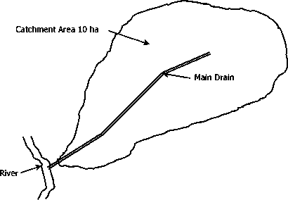
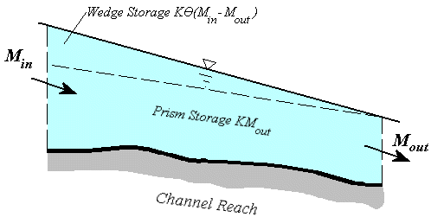
RAPID

Slide 3
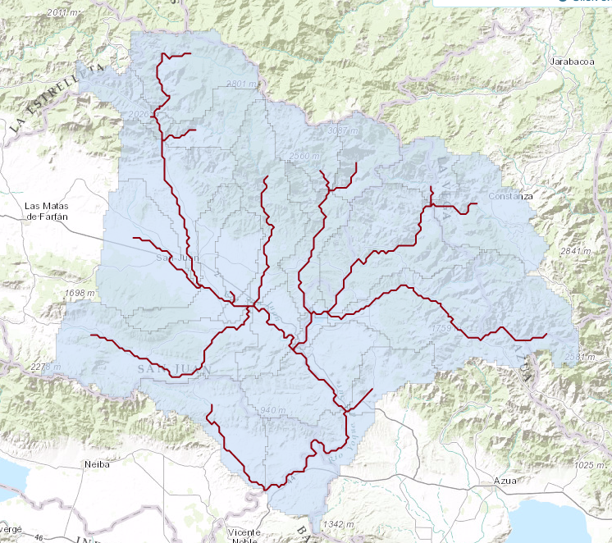
RAPID
Yaque del Sur Watershed

Slide 4
RAPID
???

Slide 5
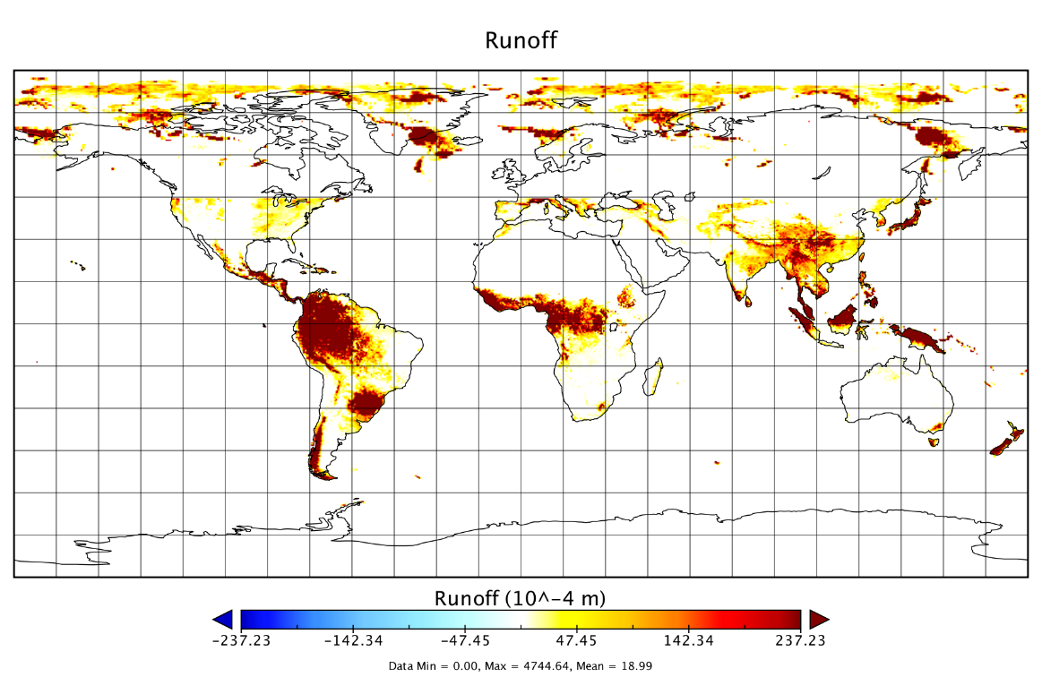
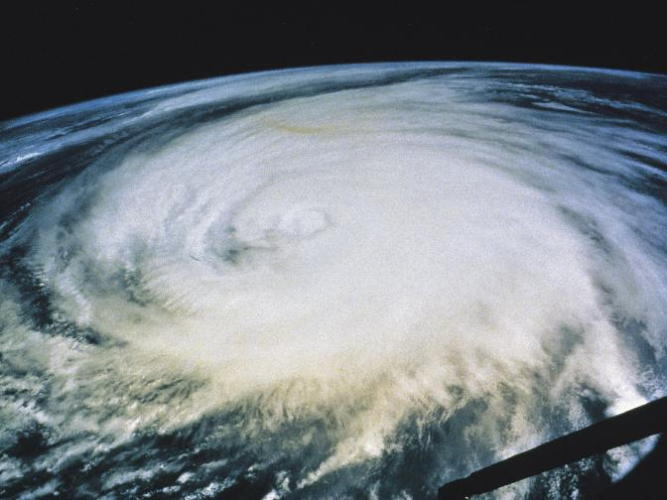
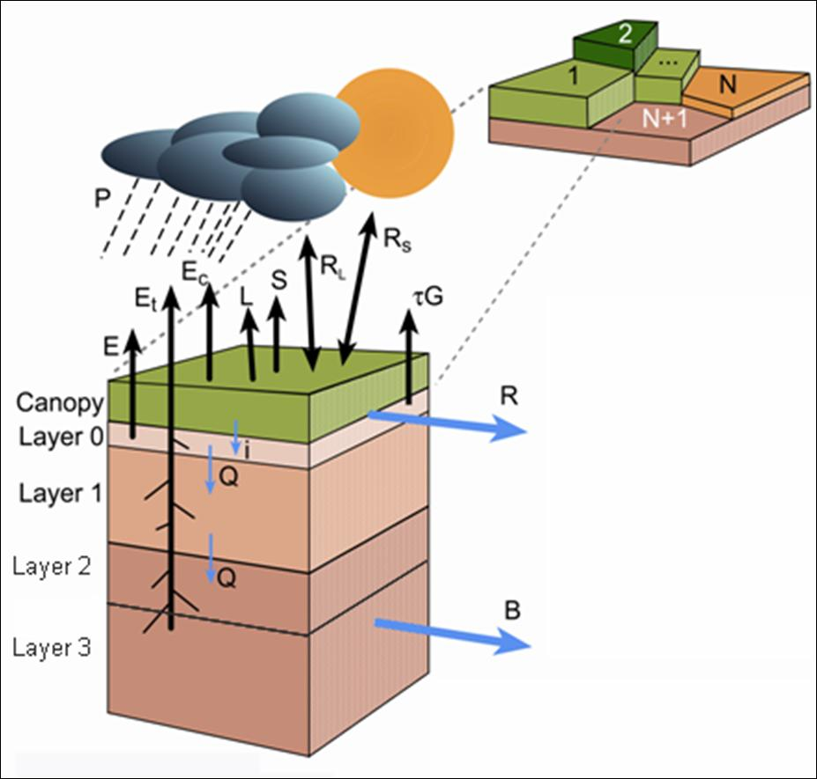
European Consortium for Medium-Range Weather Forecasts (ECMWF)
RAPID
The needed subset of data for the Yaque del Sur River can be taken from the global forecast.

Slide 6
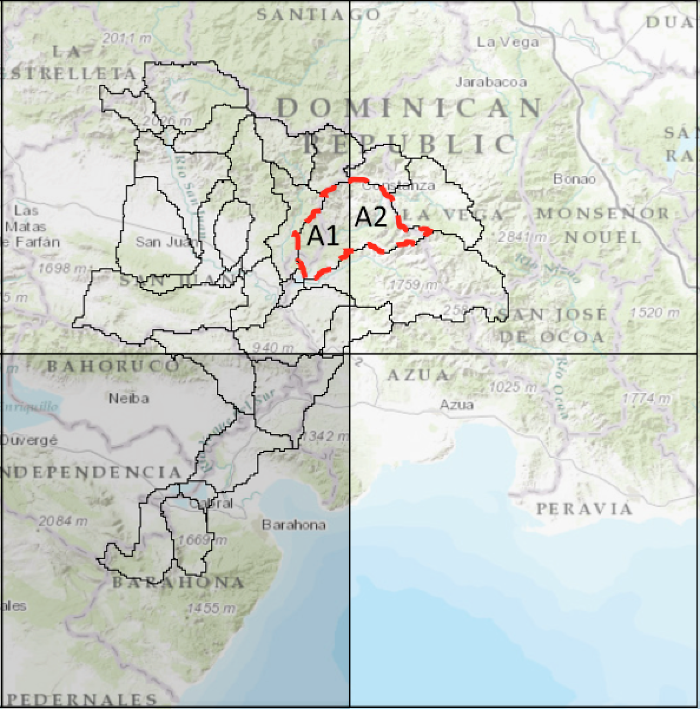
“Downscaling”
RAPID

Slide 7
RAPID model
Drainage network: | Real
Muskingum parameters: | Real? (calibrated?)
Lateral inflow: | Contrived
Initial flows: | Contrived

Slide 8
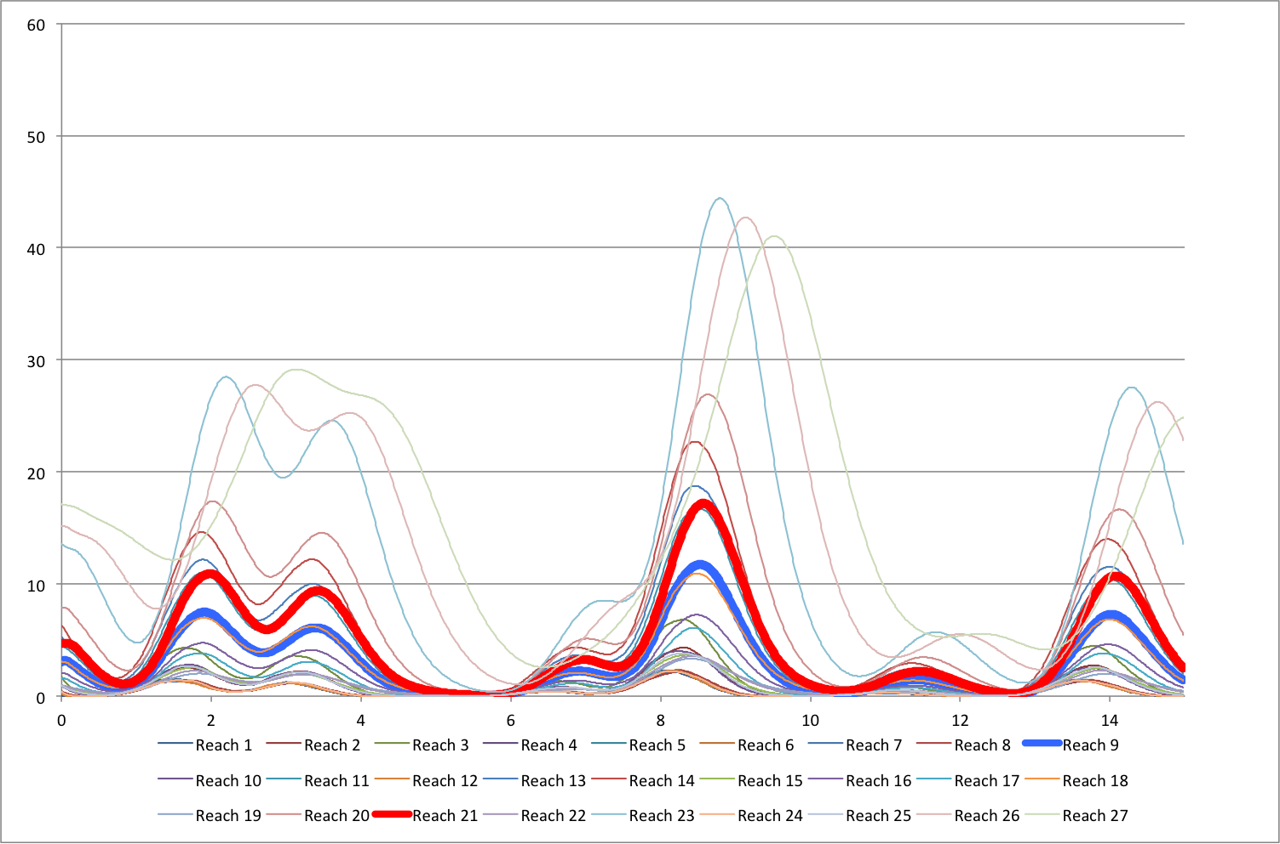
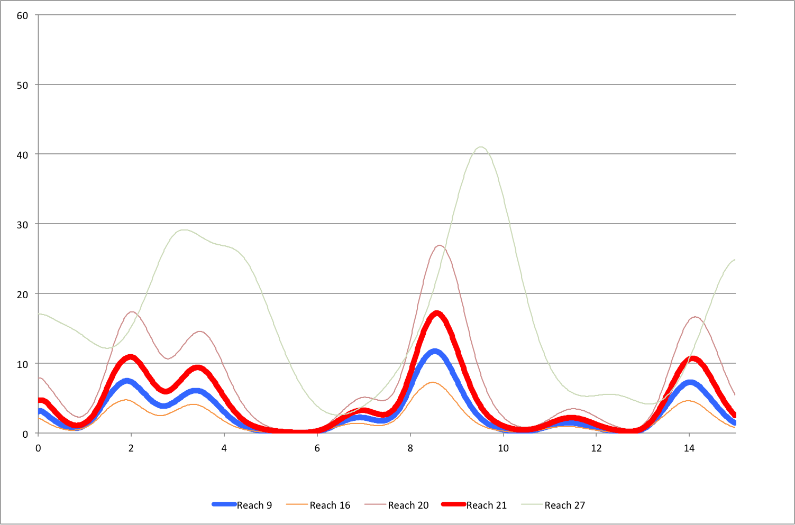
RAPID

Slide 9
Sabaneta
Sabana Yegua
RAPID + dam

Slide 10
RAPID + dam model
Drainage network: | Real
Muskingum parameters: | Real? (calibrated?)
Lateral inflow: | Contrived
Initial flows: | Contrived
Connectivity of the dams: | Real
Curve Elevation – Area: | Real
Spillways’ characteristics: | Contrived
Rules: | Contrived
Initial level in the reservoirs: | Contrived
 | Sabaneta | Sabana Yegua
Type of rule | Constant power | Constant level
Target | 3.17 MW | 380 m
Qmax | 25 m³/s | 30 m³/s
Qmin | 1 m³/s | 1.8 m³/s (real)

Slide 11
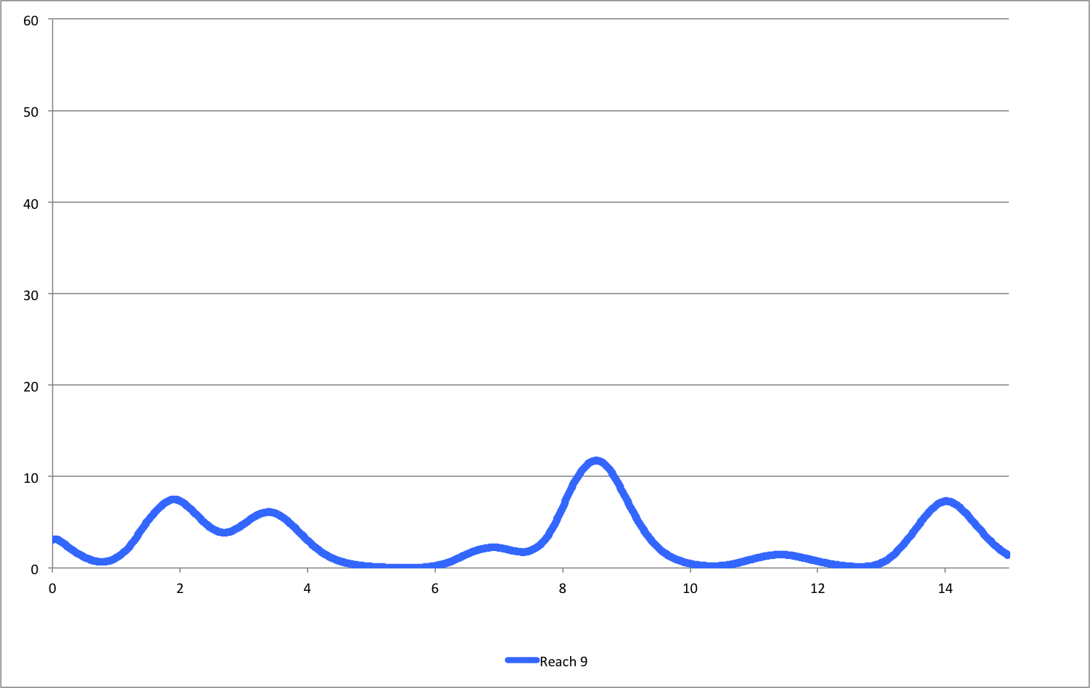
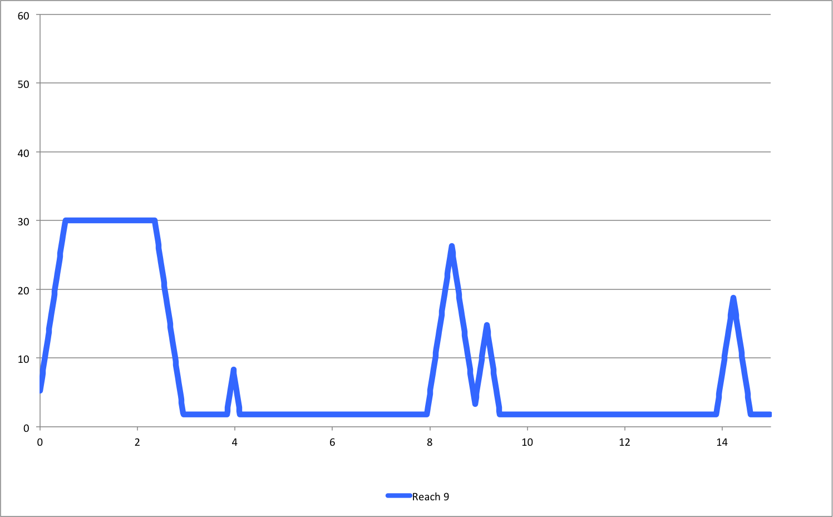
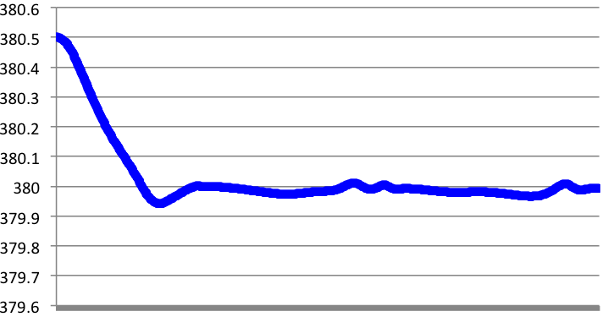
RAPID + dam

Slide 12
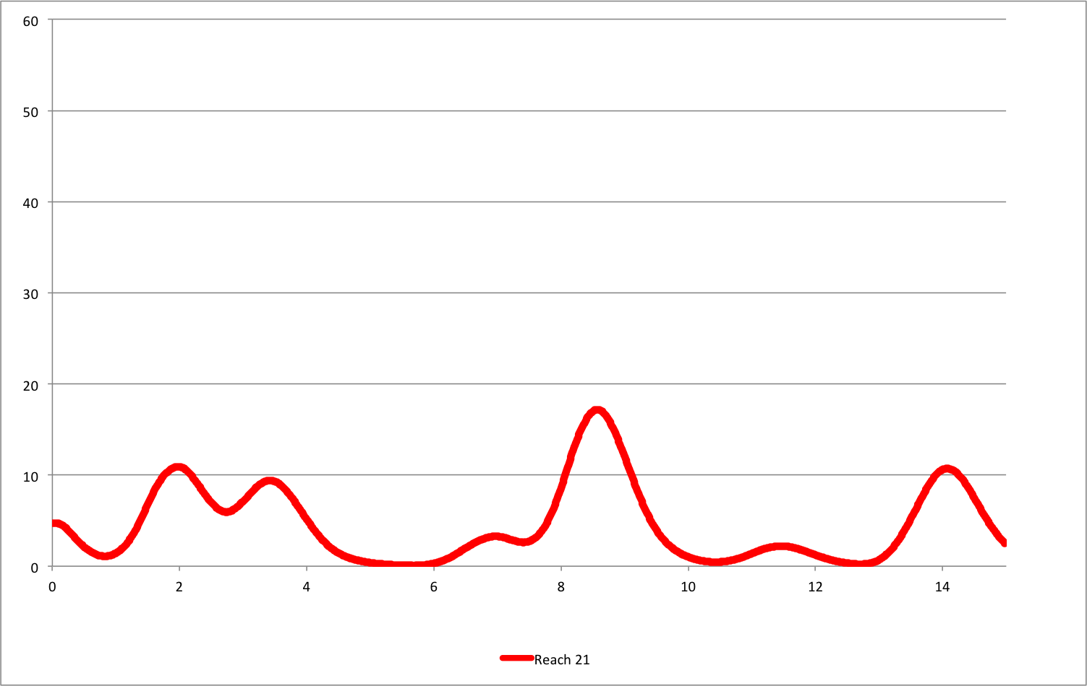
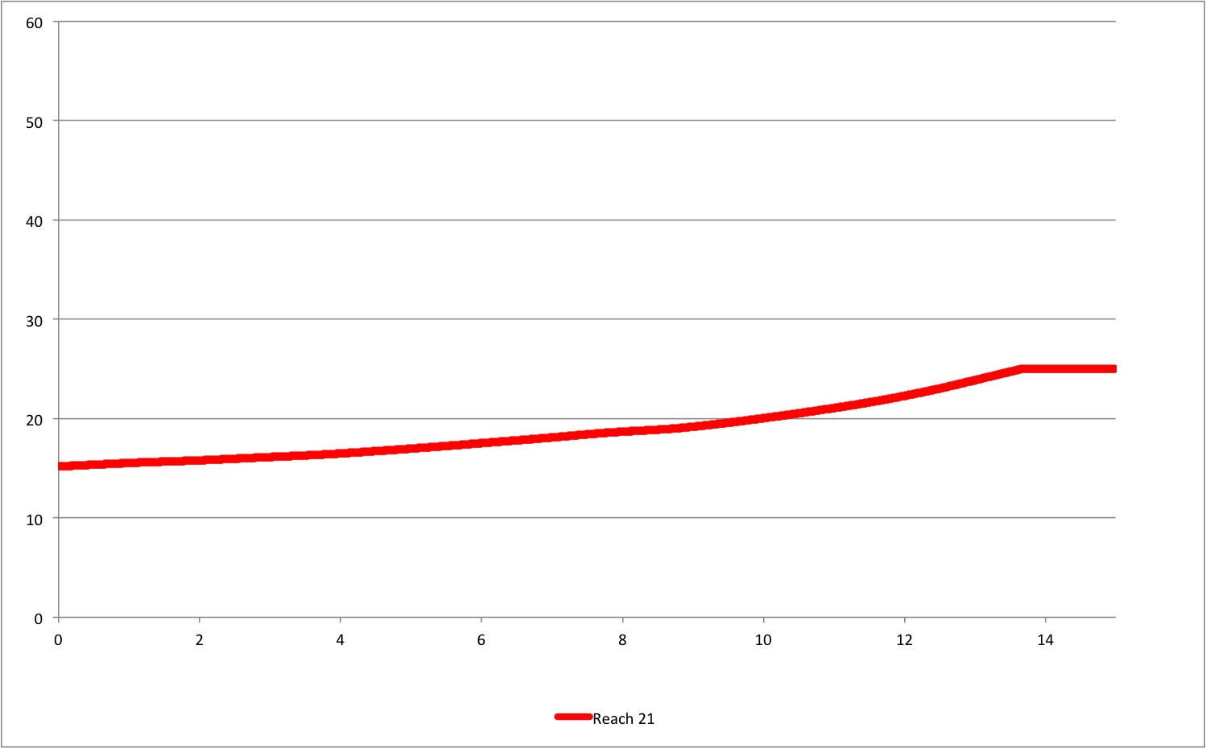
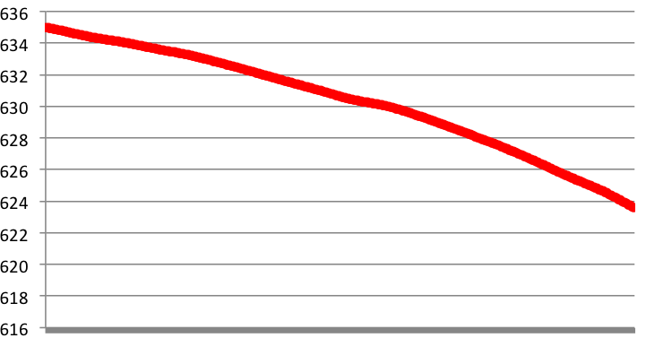
RAPID + dam

Slide 13
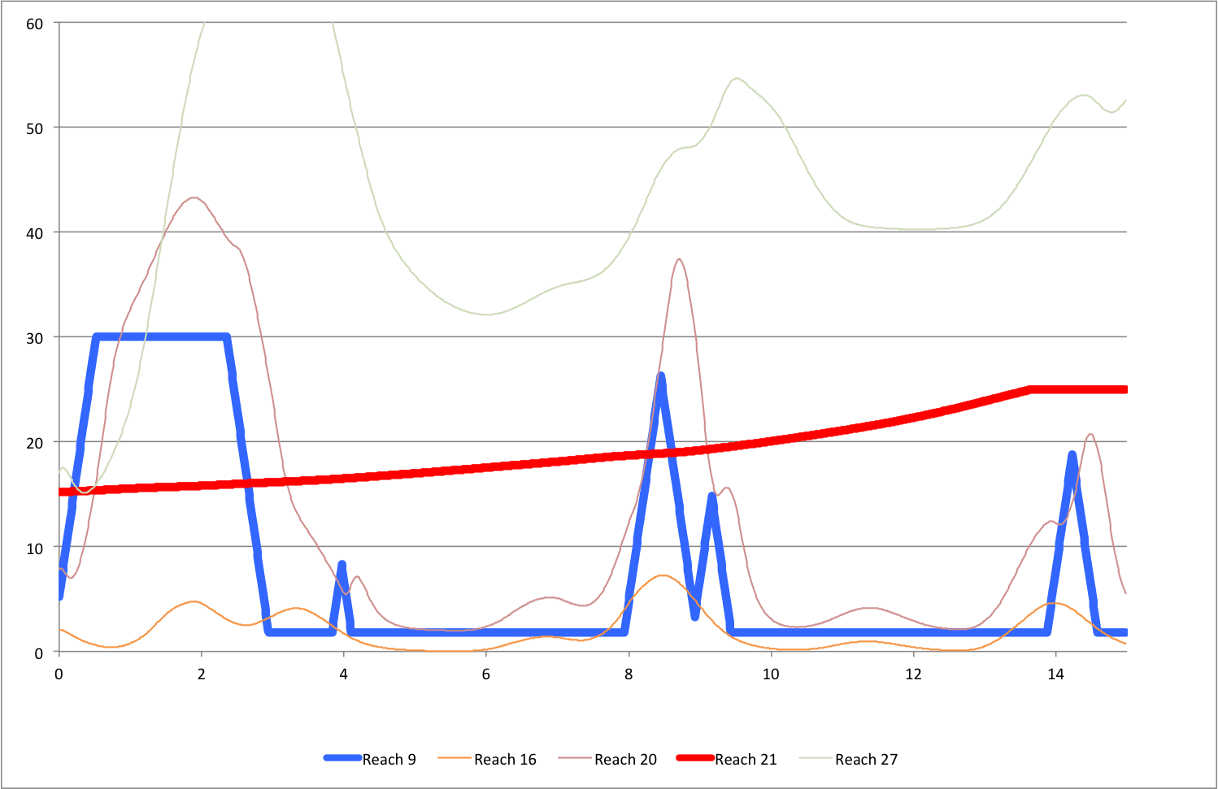

Slide 14
RAPID + dam

Slide 15
Qmax
Qmax overrides
power generation
Qmin
RAPID + dam

Slide 16
Downstream reach from both dams
Downstream reach from Sabaneta
Upstream reach
(unaffected by dams)
RAPID + dam

Slide 18
Set (read) initial flows
for each reach
create initial
lateral flow file
Set (read) general lateral flow
for the whole simulation
Slice a lateral flow for the next time step and create file
RAPID
(total run = 1 time step)
Read flows
for each reach
Replace some initial flows
with dam output flows
Set initial flow
for next time step
Pick flows to be used
as inflow into the dams
Dam module
(1 time step)
Read output flows
from each dam
Read output levels from each dam
Set (read) initial levels
for each dam
Set levels
for each dam
RAPID + dam

