Slide 1
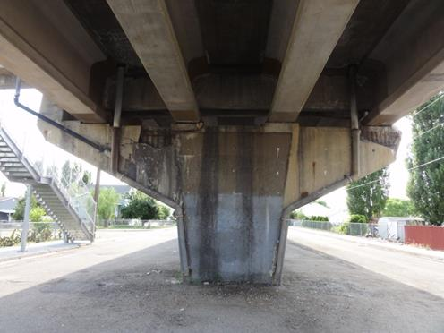
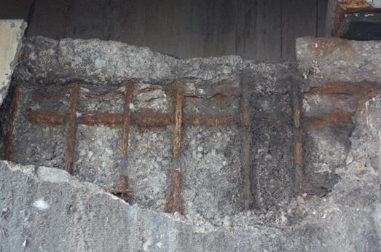
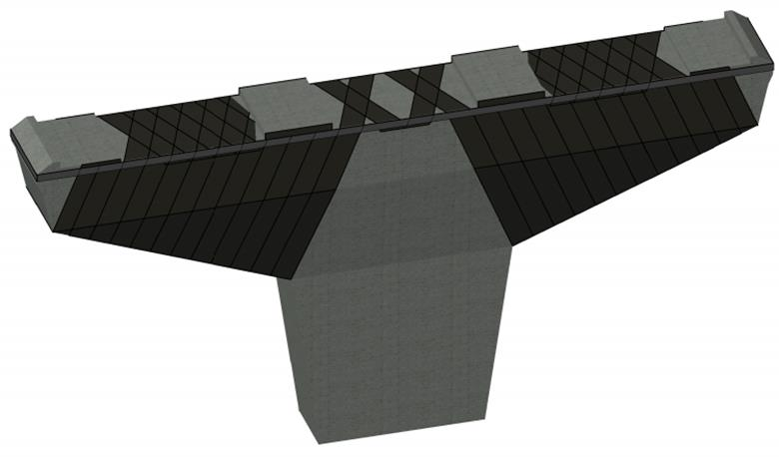
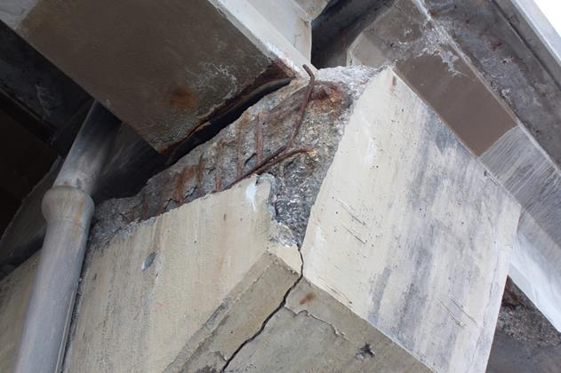
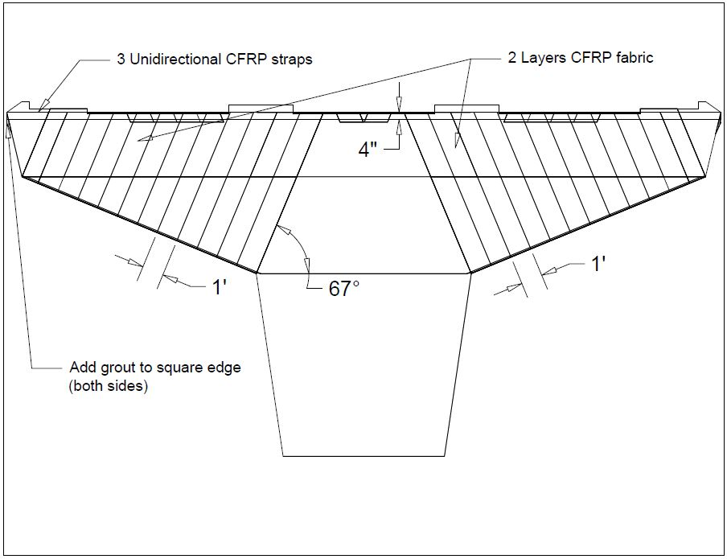
Clearfield Bridge Rehabilitation
Elkridge Engineering
Bent 8
Half-Cell Potential
Proposed FRP wrap configuration
Bent 5
Project Description:
The F330 bridge in Clearfield, Utah was built in the 1970s. The age of the bridge, along with exposure to the elements and chloride ingress have resulted in bridge components that are in various stages of deterioration. This report will focus on the condition of the bents, and study a potential carbon fiber reinforced polymer (CFRP) wrap method of exterior reinforcement to return the bents to their original capacities to resist both shear and flexure from the dead and live loads.
Results:
By applying two layers of FRP wrap on the cantilever sections of the bents and three layers of 4” wide horizontal FRP straps at the top edge, FRP wrap can provide a possible solution for the Clearfield Bridge.
Team Members:
Dan Fechner
Scoot Flannery
Justin Johnson
Ben Lesa
Faculty Advisor:
Dr. Spencer Guthrie
Graduate Mentor:
Keith Newton
Sponsor:
Michael R. Andrews

