Slide 1
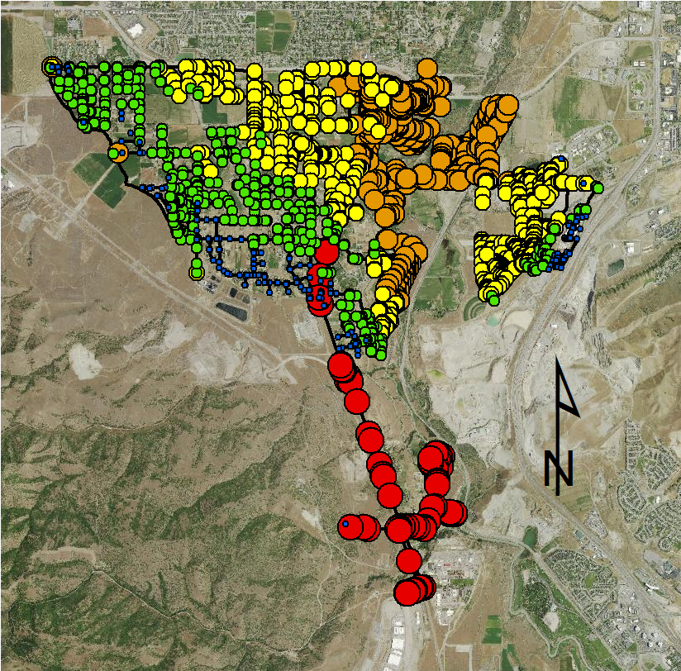
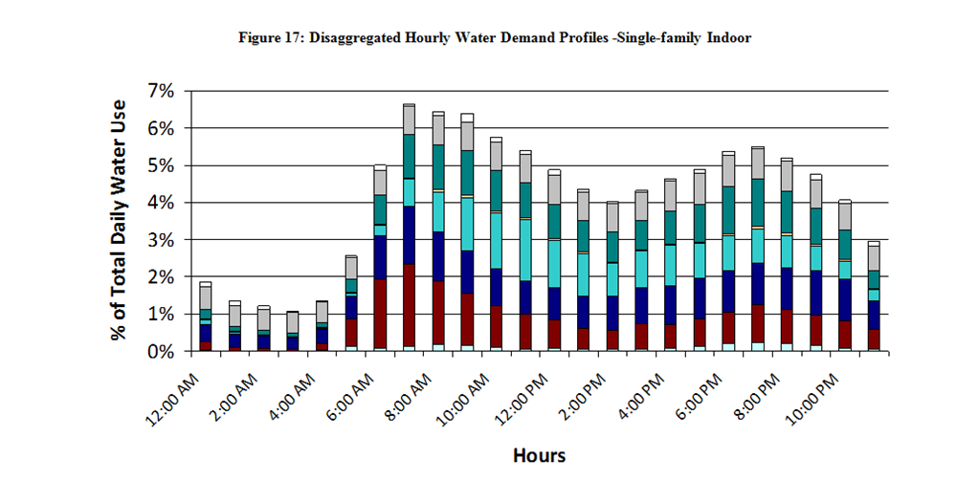
Adam Rose
Jacob Linford
Ben Felix
Water Distribution Network Modelling for the City of Bluffdale
Project Description
Bluffdale Water Network Pressure
Model Extent
The City of Bluffdale contracted with Aquaveo to create a digital inventory of their water distribution and pressurized irrigation network. This project involved the development of an EPA NET model of the existing water distribution network and the development of numerical models of the water distribution system. The ultimate goal was to determine the pressure gradient throughout the city.
Because the model was for the entire City of Bluffdale, a large amount of data processing was required.
The model included:
3692 Junctions
3790 Pipes
7 Valves
1 Tank
1 Pump
Solution
Before the data was processed and the model made, several assumptions were made in regards to each node’s elevation, reservoir head values, each pipe’s roughness coefficient, and some missing pipe diameters. Water usage patterns (like the one shown below) were also used for different kinds of buildings in the city.
After the water network data was processed, a file was loaded into EPA NET and the pressure for each node in the system was determined. A map showing the pressure gradient throughout the city is shown to the left.
Software
In order to create an accurate model of the Bluffdale water distribution network, several different software programs were used. Cody Alberts from Aquaveo previously surveyed Bluffdale’s water network, plotted the pipes and nodes in ArcMap and included most of the pipe and node attributes. Excel, ArcMap, and QGIS were then used to process the data in a format that would work in EPA NET.
Legend
Pressure (psi)
0-55.29
55.29-85.15
85.15-112.1
112.1-167.75
>167.75
Pipes
Special thanks to Aquaveo contact Cody Alberts, graduate mentor Justin Relitz, and faculty mentor Wood Miller

