Slide 1

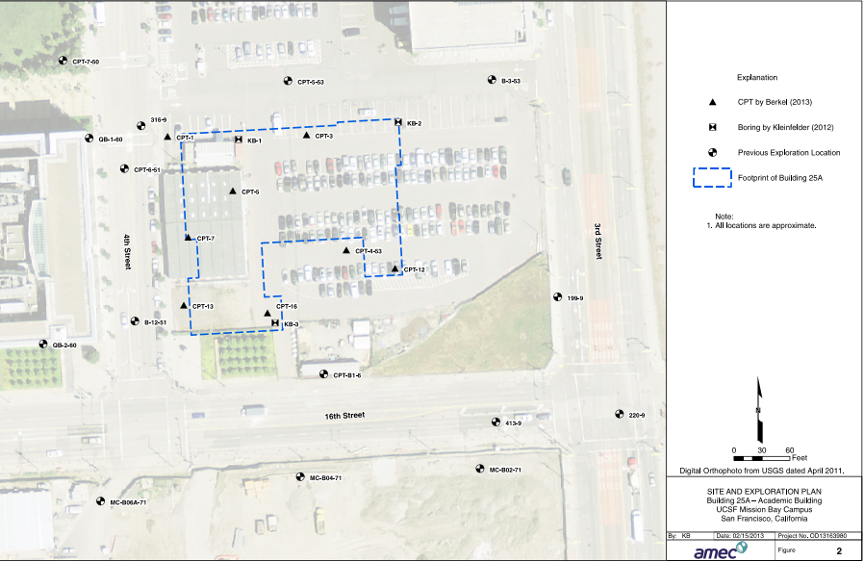
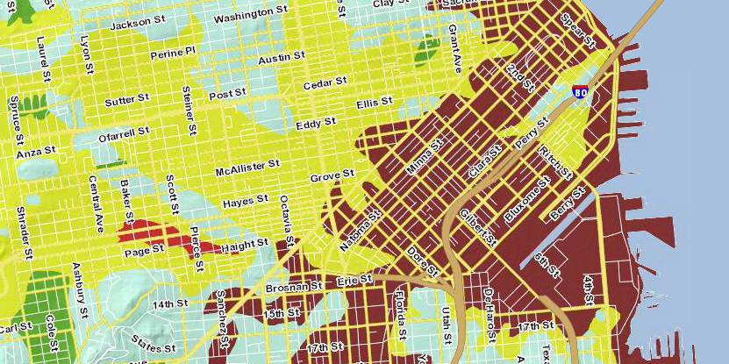
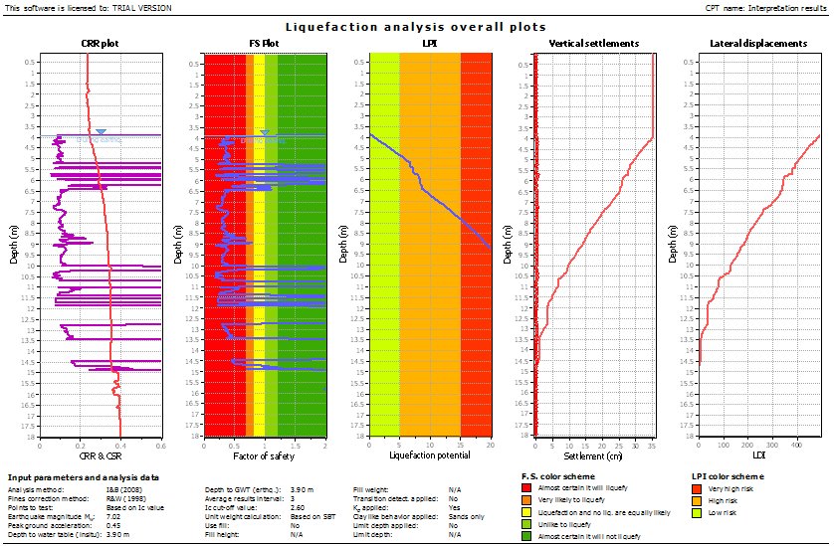
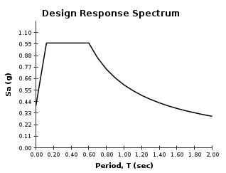
Design-Build of the Block 25A Academic Building
University of California, San Francisco, Mission Bay Campus
BFCC
Stott Bushnell, Cathryn Cecil, Tyler Cecil, and Craig Fowler – BFCC Engineering
Project Description
Seismic Hazards
The purpose of this project is to provide geotechnical evaluations and recommendations for AMEC Foster Wheeler for use in the design build of the Block 25A Academic Building for the University of California, San Francisco, Mission Bay Campus. The building will be a six story office building with a partial seventh story with a footprint of 44,000 square feet, located on the corner of 16th Street and 4th Street in San Francisco. BFCC Engineering characterized the site based on geology, existing soil, and seismic hazards and gives recommendations for retaining wall and foundation design.
The site lies in an area that has high potential for ground shaking and liquefaction due to large faults and clayey soils in the area. A design response spectrum was created to show the typical maximum accelerations for a building on the site, so that engineers could design the seismic aspects of the building accordingly. To better access the liquefaction potential, an analysis of the soil and nearby faults were done. Using liquefaction software and nearby fault data, a liquefaction hazard report was made based off the 475 and 2475 return-year earthquake. It was found that the site has high potential for liquefaction. To mitigate these hazards, it is recommended to do soil improvements, and design the foundation to resist the effects of liquefaction.
Figure 3: Site Layout with Boring Hole Locations
Foundations and Earthwork
Residential foundations are very stiff, often tied together with grade beams. They usually remain intact after liquefaction, despite large settlements (>3 in). The structures are almost always repairable
Figure 2: Boring Log Data for Northeast Section of Site
Figure 5: Site Location In Liquefaction Hazard Zone Map
Figure 1: Soil Profile of Northeast Section of Site
Soil Description
A description of the subsurface soils was created using field exploration and laboratory testing of samples. There were about 3 boring logs and corresponding analyses completed and the raw data was given to us. There were also about 8 cone penetration tests completed in various locations on the site. This data was used to complete a soil profile to make it easier to see what type of soil is present and other properties of the soil. The groundwater levels for the site is an important property gained.
Figure 7: Site Design Response Spectrum
Figure 6: Liquefaction Hazard Report
Acknowledgments
Thanks to our sponsor, Alex Wright and AMEC Foster Wheeler, for their support and guidance. Thanks as well to Dr. Kevin Franke and Levi Ekstrom for their advice and support.
Figure 4: AutoCAD Details of Recommended Foundation Pile and Retaining Wall
In general structures are designed to preserve life/safety in the event of an earthquake. But for sites that experience liquefaction and its effects, the risk to life and safety is typically low. In contrast, the economic aspect of locations that are affected by liquefaction can be devastating. In the 2011-2012 Christchurch earthquakes, there were very few deaths attributed to liquefaction, but over 20,000 residential structures were significantly damaged with estimates of up to 10,000 that were damaged beyond economic repair. In those earthquakes alone, about 20 billion dollars was attributed to liquefaction. This example teaches the lesson that when liquefaction is a concern, especially for residential structures, design should be governed by economic cost

