Slide 1
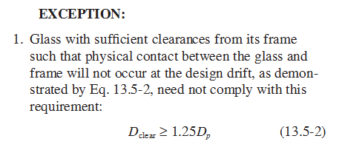
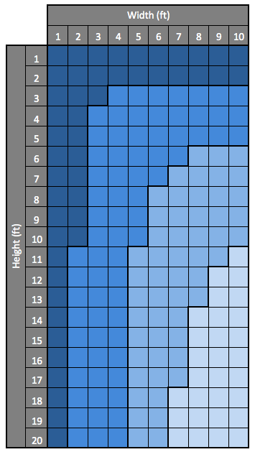
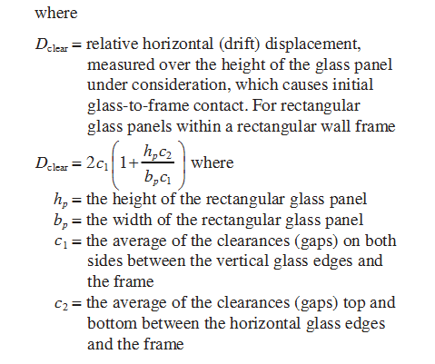
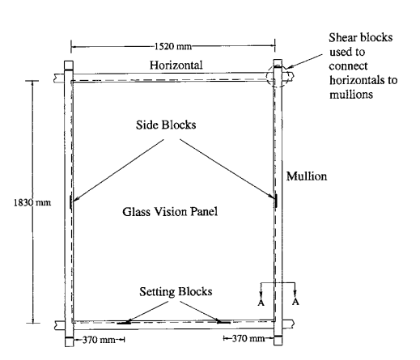
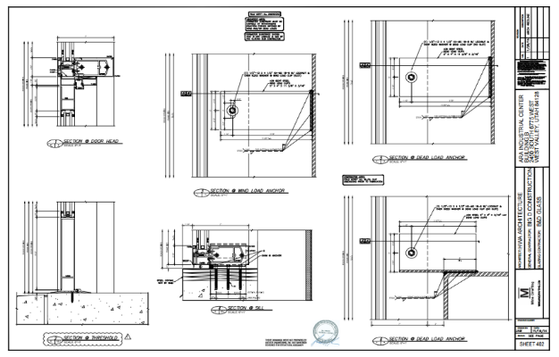
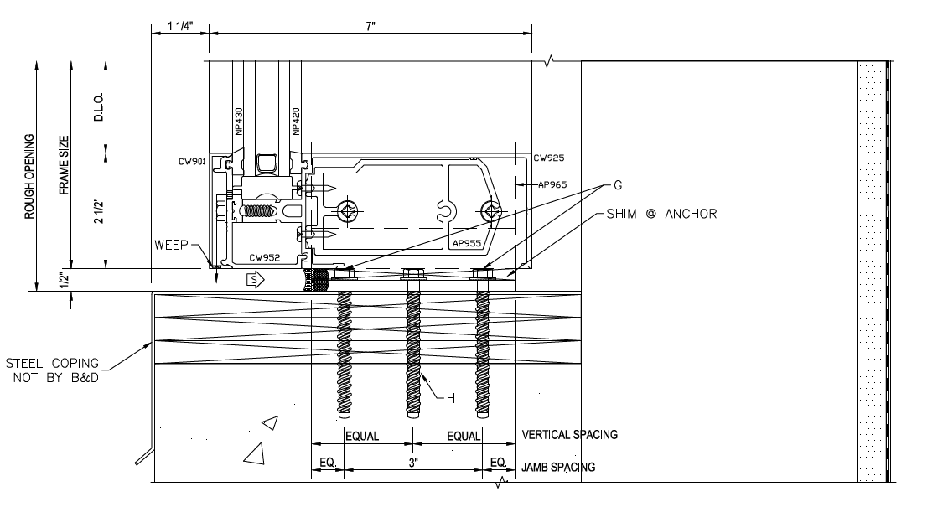
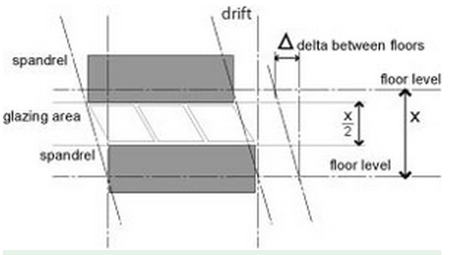
LDS Temple Window Study
Jayson Taylor, Christian Cano, Colter Lund
Window Design
Information Flow
Seismic Drift Limits
The Church of Jesus Christ of Latter-day Saints
Architect
1/8 in gaps
Recommendations
1/4 in gaps
General Contractor
In-Plane Loads
Require a professional engineer to ensure the average distances between glass edges and the window frame are in accordance with ASCE 7-10 section 13.5.9.1. Tables have been developed and provided to aid in this process
Require setting block placement to be at the quarter points of the pane of glass
Professional Engineer
3/8 in gaps
Window Glazier
Window
Manufacturer
Installation Crew
Window System Attachment
Require technical drawings to specify the attachment devices and method needed to attach the window system to the structure regardless of the size of the window
ASCE 7-10 Section 13.5.9.1
Example of Stamped Drawings
1/2 in gaps
Stained Glass Windows
Require stained glass window glaziers to comply with SGAA recommendations and provide steel supports when necessary
The above table has been created to aid in the design of gaps in window systems. The table is based on an allowable story drift equal to .01(hxx). Each section gives the minimum combination of gap sizes required for the window dimensions. This assumes that the gap is the same for c₁ and c_{2.}
Illustration of Setting Block Placement and Clearance Gaps (Behr, 2004)
Example of a Window Connection Called Out by a Professional Engineer
Detail of Window Attachment Specification.
Diagram of Lateral Drift Due to Seismic Load (Arnold, 2009)

