Slide 1
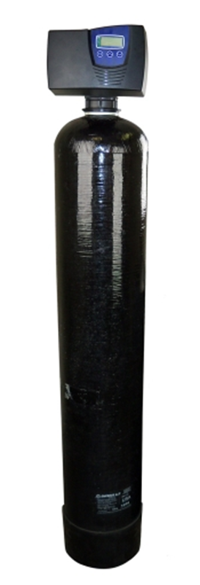
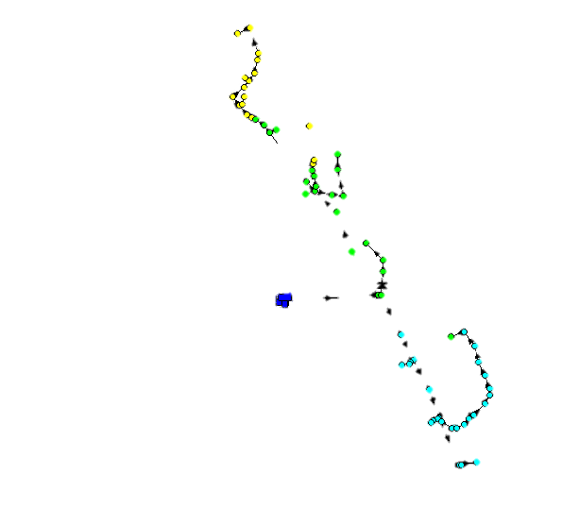
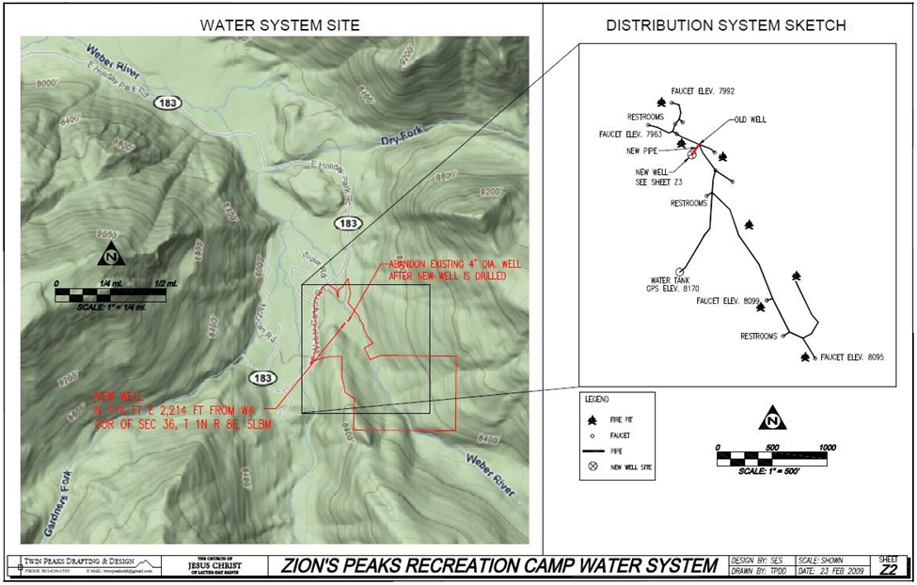
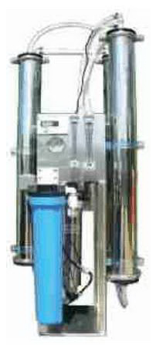
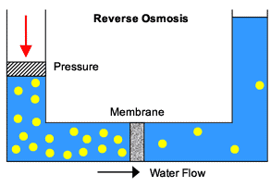
Zion’s Peak Campground Water Treatment and Distribution
Jake Nelson, Melissa Monjaras, Scott Snow
Weber Canyon, near Oakley, Utah
THE CHURCH OF
JESUS CHRIST
OF LATTER-DAY SAINTS
PROBLEM
SOLUTION
Tank
Well water has high levels of SULFATES and IRON.
Current water TANK leaks. Needs replacement.
New DISTRIBUTION SYSTEM is needed.
Design WATER TREATMENT SYSTEM to meet all water quality regulations..
Choose new WATER STORAGE FACILITY that holds water for up to 300 campers
Model a new DISTRIBUTION SYSTEM using EPANET with high density polyethylene pipes
3 ft cover depth
Polyethylene
Filtration System
The system is in series & consists of 3 stages:
First Stage: Pro-Ox Iron Filter
Removes iron and manganese
Second Stage: Antiscalant, Vitec 4000
Injected into the water to break apart calcium carbonate particles reducing scaling and hardness
Third Stage: Reverse Osmosis
Removes inorganic solids (i.e. sulfate)
Clean water is pumped to the tank
Discharge water is used to irrigate local fields and operate flushing toilets
FreeWater Systems, LLC Tank
Price | $11,188
Capacity | 6,000 gal
Pro-Ox Iron and Manganese Filter
Flow rate | 12 gpm
Backwash Flow rate | 10 gpm
Iron Removal Capacity | 15 ppm
Manganese Removal Capacity | 5 ppm
Diameter | 10 in
Height | 61.5 in
Distribution System
APPROACH
The distribution model incorporates:
Existing 1.0 hp pump and 300 ft well
New storage tank
Elevation
Coefficient of friction
Pressure change
Base water demand at each outlet location
Water is distributed to 12 locations (including 3 restroom sites)
Reverse Osmosis LP-7500
GPD | 7500
Production GPM | 5.2
Rejection GPM | 6.8
Recovery | 43%
Dimensions WxDxH | 22x23x64
Component | Cost Estimate
Iron Filtration | $1,200
Antiscalant | $64-$160/year
Injection Unit | $400
Reverse Osmosis | $4,950
Ira A. Fulton College of Engineering and Technology
Civil and Environmental Engineering Capstone Project
Brigham Young University –Provo, Utah

