Slide 1
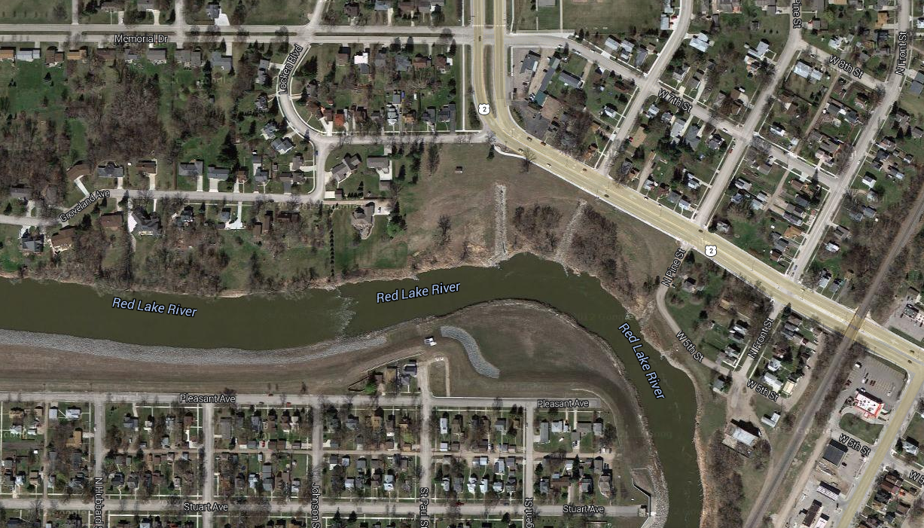
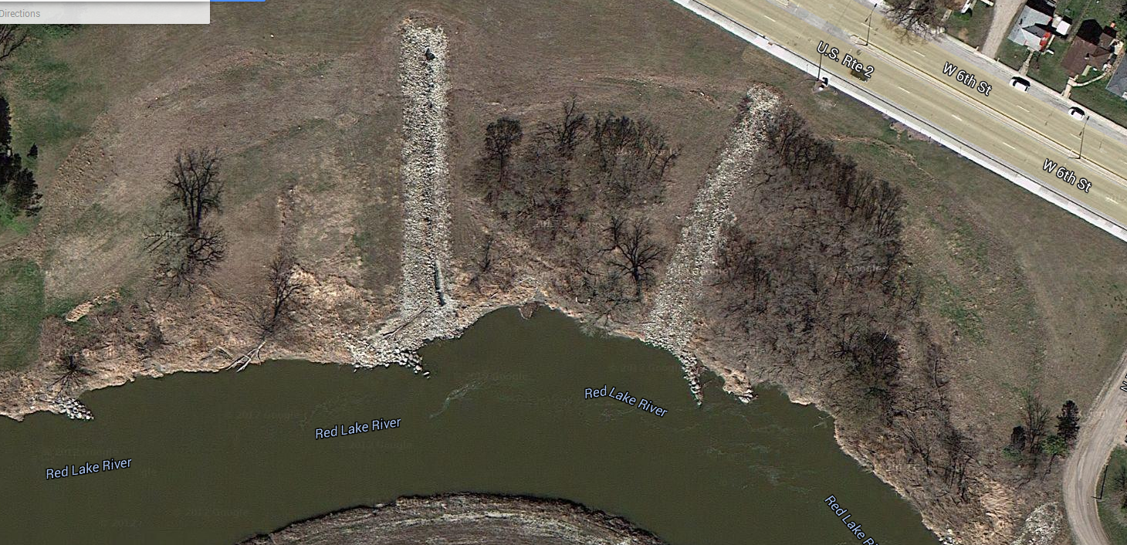
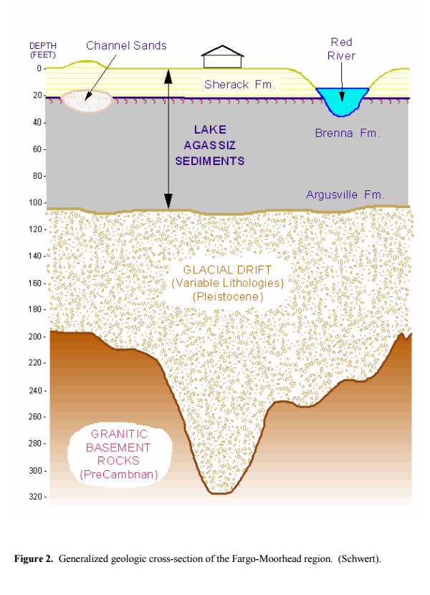
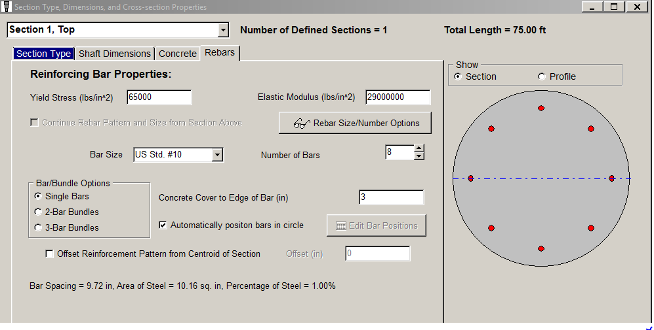
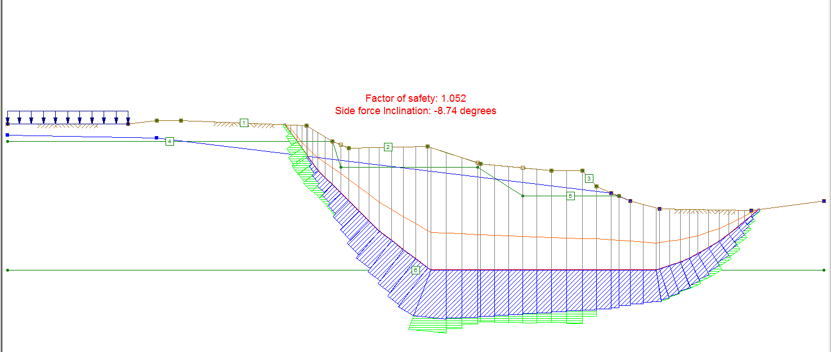
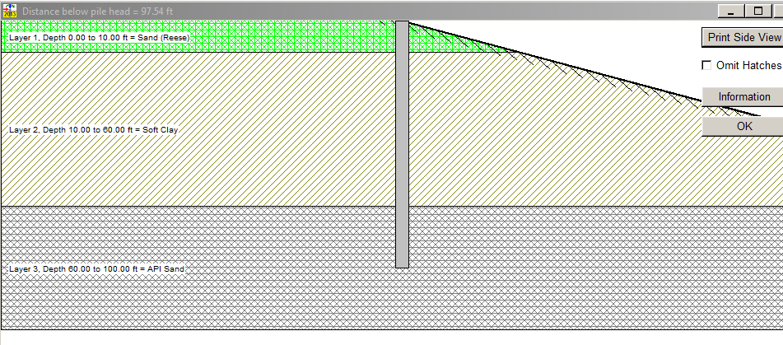
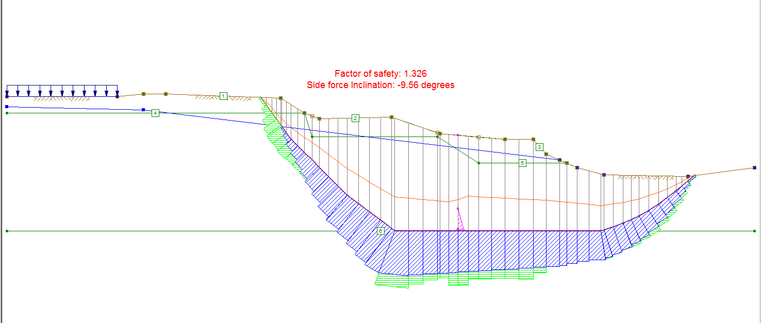
CROOKSTON MINNESOTA SLOPE STABILITY PROJECT
OBELISK ENGINEERING
Kenneth Hunter
Shawn Crawley
Alex Arndt
CROSS-SECTION LOCATION
OVERVIEW:
In 2003, massive damage was caused by a slope failure near the center of the town of Crookston Minnesota. The city of Crookston has contracted out for a design-build solution to stabilize the slope and prevent damage to the nearby highway.
800 ft*
*89 SHAFTS SPACED AT 9’ O.C.
SITE CONDITIONS:
This site exists on top of a unique geological area that has contributed to the slope failure. This area historically was covered by a gigantic glacial lake which over time deposited over 60 ft. of weak clay which the site overlays. These weak clays have contributed to an unstable slope near the river even with the slope being less than 15 degrees.
DESIGN:
Using Both UTEXAS4ED and LPILE a linear drilled shaft system was designed that would supply a sufficient resistive force to the moving slope to raise the factor of safety from 1 to 1.3
By using an iterative method optimal shaft dimensions and spacing were calculated.
ORIGINAL
Layer 1. Depth 0.00 to 10.00 ft = Sand (Reese)
Layer 2. Depth 10.00 to 60.00 ft = Soft Clay
Basic soil layers
Layer 3. Depth 60.00 to 100.00 ft = API Sand
COST ANALYSIS:
Materials $ 550,000
Labor $ 1,750,000
Equipment $ 1,000,000
Total $ 3,300,000
ANALYSIS:
With the onsite soil data collected from the site and other geological information about the area, a model of the slope was made using the Slope Stability Software UTexas4Ed. From this analysis the slope was characterized as a deep slope failure caused by the weak shear strengths of the thick clay layer. Also from the analysis it was found that the slope would be further stressed by rapid drawdown conditions that could potentially occur in the area.
FINAL
RECOMMENDATION: After careful research and analysis several options were considered for resisting the slope failure. Because of the unique nature of this deep slope failure the concrete shaft solution does seem to be a viable option for this project.

